Slide 1






TEXT CLASSIFIER
SAI SAKTHI.U
III -CSE

Slide 2


INTRODUCTION
A text classifier is a type of machine learning model that is trained to categorize or classify text data into predefined categories or labels.
Text classification is a fundamental task in natural language processing (NLP) and is used in various applications such as spam detection, sentiment analysis, topic categorization, and more.
A text classifier is a machine learning model that categorizes text data into predefined categories or labels. It converts text into numerical features, learns from labeled training data, and predicts labels for new text based on learned patterns.

Slide 3
AGENDA
OBJECTIV AND SCOPE: Identify the problem you want to solve with text classification (e.g., sentiment analysis, topic categorization, spam detection).
Determine the scope of the project, including the types of text data you'll work with and the desired outcomes.
DATA COLLECTION AND PREPARATION: Gather labeled data, preprocess it, and split into sets.
FEATURE REPRESENTATION : Choose BoW, TF-IDF, embeddings, or transformers for numerical features.
MODEL SELECTION AND TRAINING: Choose a model, train it, and tune hyperparameters.

Slide 4
5. EVALUATION AND VALIDATION: Assess model performance using metrics on test data.
6. DEPLOYMENT AND INTEGRATION: Deploy and integrate the model into the production environment.
7. MONITORING AND MAINTAINANCE: Monitor performance and plan for maintenance.
8. DOCUENTATION AND REPORTING: Document the process and prepare a report or presentation.

Slide 5
PROBLEM STATEMENT
Develop a text classifier to automatically categorize customer reviews into positive, neutral, or negative sentiments for a product. The classifier should analyze textual data, extract key features, and accurately assign sentiment labels. This solution aims to streamline sentiment analysis processes, improve customer feedback analysis, and enhance decision-making for product development and marketing strategies.

Slide 6
PROJECT OVERVIEW
The text classifier project focuses on developing a machine learning model to categorize text data into predefined categories or labels. Using a labeled dataset, the project involves data preprocessing, feature extraction (e.g., Bag of Words, TF-IDF), model selection (e.g., Naive Bayes, SVM, deep learning models), and evaluation using metrics like accuracy, precision, and recall. The goal is to build an accurate and robust text classification system that can be deployed for various applications such as sentiment analysis, spam detection, or topic categorization. The project aims to leverage NLP techniques to automate text analysis tasks and improve decision-making processes.

Slide 7
WHO ARE THE END USERS ?
Business analysts
Customer support teams
Marketing professionals
Spam filtering systems
Content moderators
Researchers
Developers

Slide 8
YOUR SOLUTION AND ITS PROPOSISTION
SOLUTION: Develop a text classifier using machine learning algorithms and natural language processing techniques to categorize text data into predefined categories or labels.
VALUE PROPOSISTION:
Automation: Automates text analysis tasks, saving time and effort.
Accuracy: Provides accurate categorization and sentiment analysis.
Efficiency: Improves decision-making processes with data-driven insights.
Scalability: Scales to handle large volumes of text data.
Versatility: Applicable across various industries and use cases for text classification need

Slide 9
THE WOW IN YOUR SOLUTION
text classifier solution lies in its ability to seamlessly integrate cutting-edge machine learning algorithms and natural language processing techniques, offering:
Precision and Accuracy: Utilizes advanced models for highly accurate text categorization and sentiment analysis.
Scalability: Handles large volumes of text data efficiently, ensuring scalability for growing needs.
Adaptability: Customizable and adaptable to various industries and use cases, meeting diverse text classification requirements.
Automation: Streamlines text analysis tasks, saving time and resources while enhancing productivity.
Insights: Provides valuable insights from text data, empowering informed decision-making and strategy development.

Slide 10
Insights: Provides valuable insights from text data, empowering informed decision-making and strategy development.

Slide 11
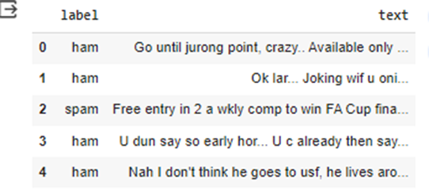
RESULT

Slide 12

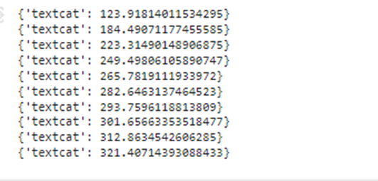

Slide 13
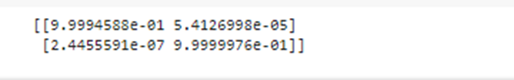
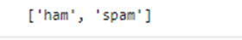

Slide 14
Thank
you!

